Slide 1



MedGrad E-CLIP: Enhancing Trust and Transparency in AI-Driven Skin Lesion Diagnosis
Sadia Kamal, Tim Oates
University of Maryland Baltimore County

Slide 2
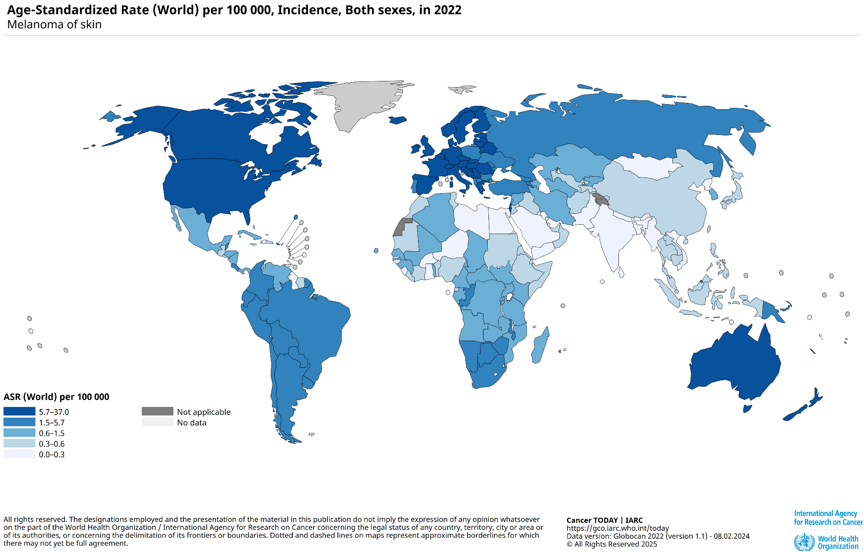
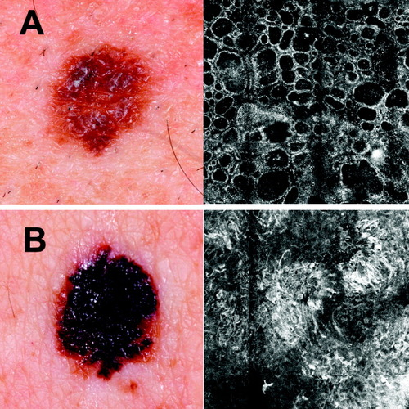
Introduction
Skin cancer is the most common cancer globally, with early detection being crucial for treatment.
AI-based diagnostic systems improve accuracy. However, these models function as "black boxes," leading to concerns regarding explainability and trust among clinicians.
Our Contribution: We propose MedGrad E-CLIP, an entropy-based explainability method that improves AI transparency for skin lesion diagnosis.
Comparison of benign (A) and malignant (B) pigmented lesions

Slide 3
Research Motivation
Traditional AI-based diagnostic models lack transparency and clinician trust.
Existing explainability methods (e.g., Grad-CAM, Grad E-CLIP) struggle with fine-grained medical details.
Our work improves model interpretability by linking visual lesion features to descriptive diagnostic criteria.

Slide 4
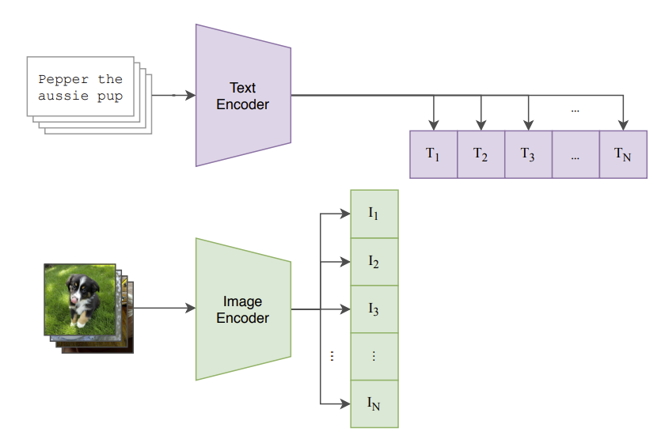
CLIP(Contrastive Language-Image Pre-Training)
Research Problem
What is CLIP?
CLIP (Contrastive Language-Image Pre-Training) is a neural network trained on a variety of (image, text) pairs.
Learns relationships between images and text.
Uses a dual encoder (image & text) to map data into a shared embedding space.
Applications of CLIP
Used in Zero Shot Image classification.
Helps in image-text retrieval
Enables multimodal learning (text & images together)
CLIP Model

Slide 5
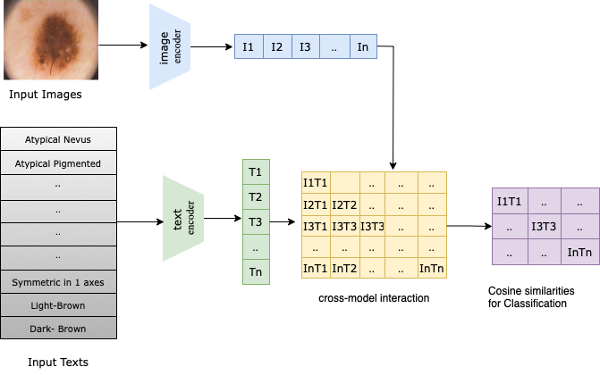
CLIP for skin lesion
CLIP Model for Skin Lesion Diagnosis
CLIP (Contrastive Language-Image Pretraining) is trained on a custom dataset of dermoscopic images and textual descriptions. Images and textual diagnostic criteria are embedded into a shared representation space, allowing it to learn meaningful associations between visual features and diagnostic terms.
The model classifies 17 distinct skin lesion types as classes by measuring the cosine similarity between feature representation of an image and its corresponding textual descriptions.

Slide 6
Datasets and Preprocessing
Datasets:
PH² dataset (~200 dermoscopic images of melanocytic lesions, including common nevi, atypical nevi, and melanomas. These includes clinical and histological diagnoses and the identification of several dermoscopic structure criteria).
Derm 7pt dataset (~2000 clinical and dermoscopy images along with corresponding structured metadata following the 7-point checklist).
Data Preprocessing:
Images resized to 224x224 pixels and augmented.
Text descriptions cleaned, augmented, and tokenized.
Image-text pairs generated for contrastive learning.

Slide 7

MedGrad E-CLIP Methodology
Extends Grad E-CLIP by introducing entropy-weighted mechanism to capture fine-grained features.
Instead of only focusing on high-gradient areas , our method:
Computes local entropy to identify subtle lesion features.
Distributes attention more evenly, ensuring that critical but less prominent features are highlighted.
Improves alignment between visual and textual diagnostic descriptions.
Computed weighted entropy
Flattened Heatmap
Channel importance
Pixel values at spatial location i

Slide 8

MedGrad E-CLIP Methodology
H_{i​}: Final heatmap highlighting important spatial locations.
w_{c}​: Channel importance weight, indicating the contribution of each feature channel.
v_{i​}: Feature representation at spatial location.
w_{e}:computes a lo- cal entropy within the region covered by the disk around each pixel that emphasizes minute changes
Channel Importance Calculation:
Measures how much each feature channel influences the final similarity score S(f_{I​}).
Computed by taking the gradient of the similarity score with respect to the class token output o_{cls​.}
Final Heatmap Processing:
For Image Encoder:
The heatmap H_{i} is reshaped and interpolated to match the original image size.
For Text Encoder:
The heatmap maps importance scores to individual tokens, aligning them with the original sentence structure.
Layer-Wise Aggregation:
The final explanation is obtained by recursively aggregating heatmaps from each layer.
In our experiments, we use the last layer to explain the image.

Slide 9
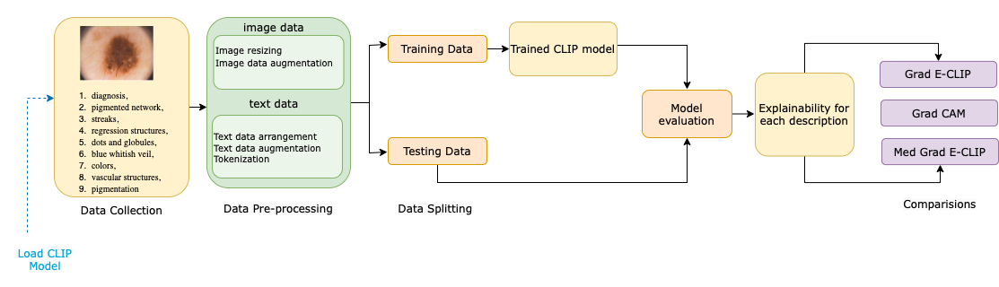
Proposed Pipeline

Slide 10
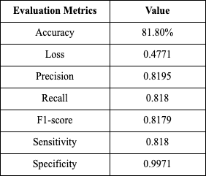
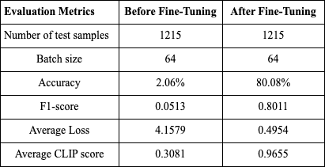
Results
CLIP Model Performance
Table 1: Model metrics on Training data
Table 2: Model metrics on test data before and after fine tuning

Slide 11
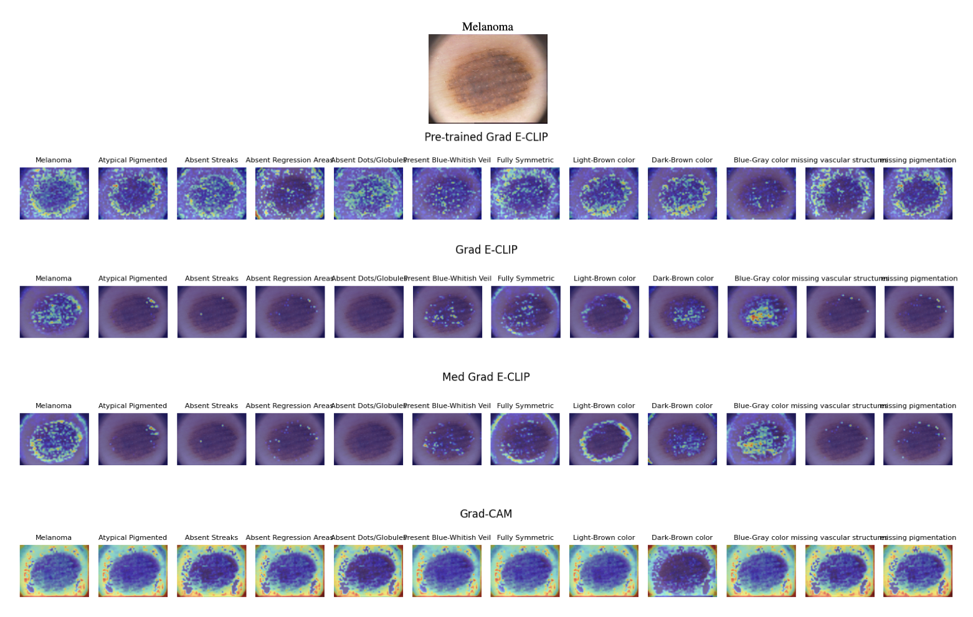
Result
MedGrad E-CLIP Results

Slide 12
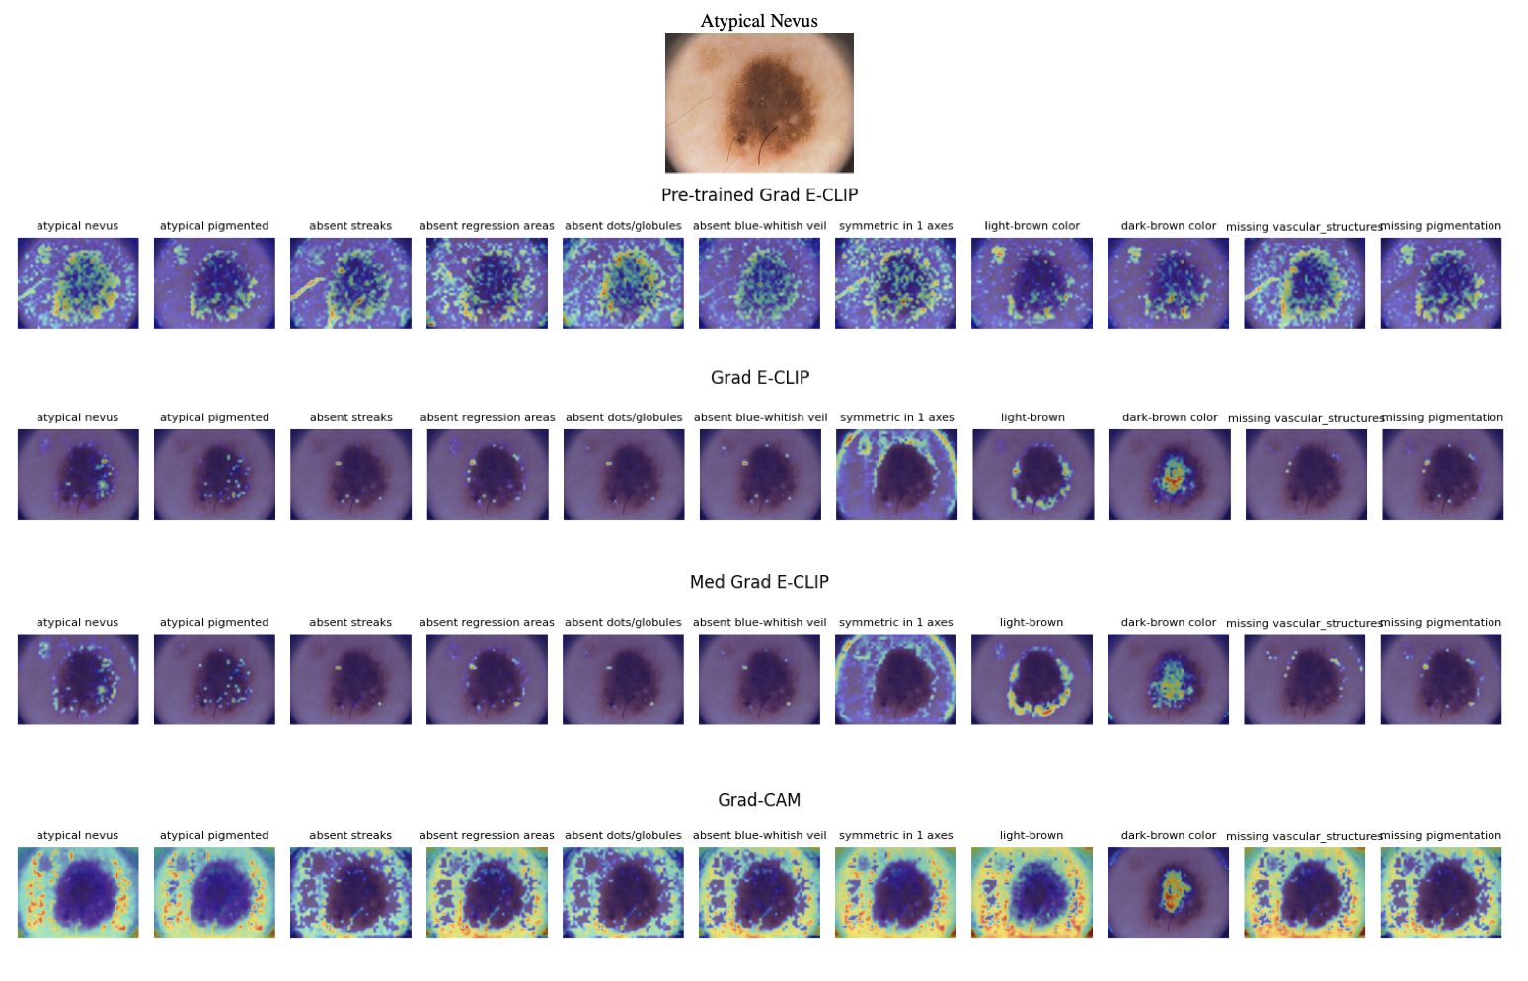
Results
MedGrad E-CLIP Results

Slide 13
Conclusion
Developed MedGrad E-CLIP, an improved explainability method tailored for medical images.
Introduces weighted entropy mechanism to highlight subtle yet diagnostically crucial features.
Enhances transparency and trust by linking image features with diagnostic descriptions.
Outperforms Grad-CAM and Grad E-CLIP by capturing fine-grained lesion details.

Slide 14
Limitations and Future Work
Limitation
Some cases may have weak alignment between image features and textual descriptions, affecting explainability.
The model sometimes emphasizes irrelevant regions, leading to potential over-explanations.
Performance and generalizability depend on dataset diversity; more extensive clinical validation is needed.
Future Work
Expand the dataset, improve annotation granularity, and conduct quantitative evaluations to enhance performance
Collaborate with dermatologists to conduct clinical trials, ensuring the model's efficacy and real-world applicability.
Test the model's resilience against adversarial attacks for enhanced reliability.

Slide 15

Thank you!
arXiv Paper

